Slide 1
TECHNOLOGY IN ACTION
Alan Evans * Kendall Martin * Mary Anne Poatsy
Chapter 10
Behind the Scenes: Software Programming
Notes:
In this behind-the-scenes chapter, we explore the stages of program development and survey the most popular programming languages.

Slide 2
Understanding Programming
Life Cycle of an Information System
Life Cycle of a Program
Notes:
In this section, several key concepts about understanding programming will be evaluated. These include the Life Cycle of an Information System and the Life Cycle of a Program.

Slide 3
Life Cycle of an Information System
Objectives
10.1 Describe the importance of programming to both software developers and users.
10.2 Summarize the stages of the system development life cycle (SDLC).
Notes:
The two objectives involved in understanding the life cycle of an information system are:
10.1 Describe the importance of programming to both software developers and users.
10.2 Summarize the stages of the system development life cycle (SDLC).

Slide 4
Life Cycle of a Program (1 of 2)
Objectives
10.3 Define programming and list the steps in the program development life cycle (PDLC).
10.4 Describe how programmers construct a problem statement from a description of a task.
10.5 Explain how programmers use flow control and design methodologies when developing algorithms.
Notes:
Three of the objectives involved in understanding the life cycle of a program are:
10.3 Define programming and list the steps in the program development life cycle (PDLC).
10.4 Describe how programmers construct a problem statement from a description of a task.
10.5 Explain how programmers use flow control and design methodologies when developing algorithms.

Slide 5
Life Cycle of a Program (2 of 2)
Objectives
10.6 Discuss the categories of programming languages and the roles of the compiler and the integrated development environment (IDE) in coding.
10.7 Identify the role of debugging in program development.
10.8 Explain the importance of testing and documentation in program development.
Notes:
The final three objectives involved in understanding the life cycle of a program are:
10.6 Discuss the categories of programming languages and the roles of the compiler and the integrated development environment (IDE) in coding.
10.7 Identify the role of debugging in program development.
10.8 Explain the importance of testing and documentation in program development.

Slide 6
Life Cycle of an Information System
Some tasks are complex
Require creative thought
Require human touch
Some tasks are candidates for automation
Repetitive
Work with electronic information
Follow a series of clear steps
Notes:
Every day we face a wide array of tasks. Some tasks are complex. These tasks require:
Creative thought.
Human touch.
But some tasks are candidates for automation with computers—automation achieved through programming:
Tasks that are repetitive.
Those that work with electronic information.
Those that follow a series of clear steps.

Slide 7
Life Cycle of an Information System The Importance of Programming (Objective 10.1)
A career in programming offers:
Plentiful jobs
Strong salaries
Telecommuting is often easy to arrange
Programming is necessary when there is no existing software for the task
Basic knowledge of programming to use macros
Notes:
A career in programming offers many advantages:
Jobs are plentiful.
Salaries are strong.
Telecommuting is often easy to arrange.
If you can’t find an existing software product to accomplish a task, programming is mandatory.
Having a basic knowledge of programming enables you to add features that support your personal needs. If you plan to create custom applications from scratch, having a detailed knowledge of programming will be critical to the successful completion of your projects. It also helps you understand how to create and use macros.

Slide 8
Life Cycle of an Information System System Development Life Cycle (1 of 2) (Objective 10.2)
Information System
Collection of pieces working to achieve a common goal
An information system includes:
Data
People
Procedures
Hardware
Software
Notes:
Generally speaking, a system is a collection of pieces working together to achieve a common goal. Your body, for example, is a system of muscles, organs, and other groups of cells working together.
An information system includes data, people, procedures, hardware, and software that help in planning and decision making. Information systems help run an office and coordinate online-purchasing systems and are behind database-driven applications used by Amazon and Netflix.

Slide 9
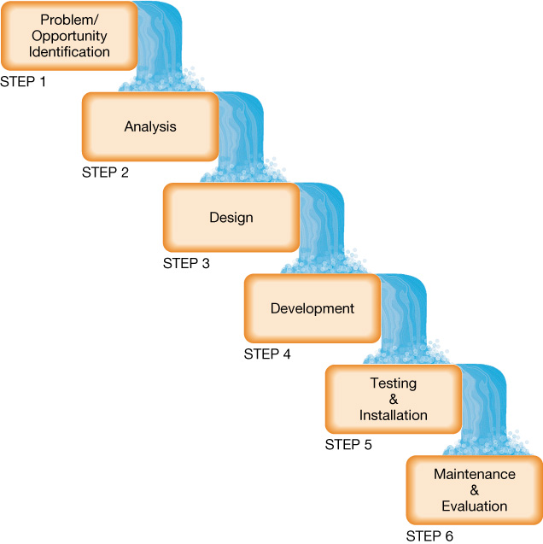
Life Cycle of an Information System System Development Life Cycle (2 of 2) (Objective 10.2)
Steps of the SDLC
Problem and Opportunity Identification
Analysis by developing the program specification
Design using data flow diagrams
Development of the actual program
Testing and Installation to insure it works
Maintenance and Evaluation to maintain usefulness
Notes:
There are six steps in a System Development Life Cycle (SDLC) model.
Corporations form a development committee to evaluate proposals.
Analysts explore the problem, develop a program specification, define user requirements, and recommend a plan of action.
A plan using flowcharts and data-flow diagrams helps programmers.
Program development begins next.
Testing and installing the program ensure it works properly.
Program performance is monitored to determine whether the program is meeting the needs of end users.

Slide 10
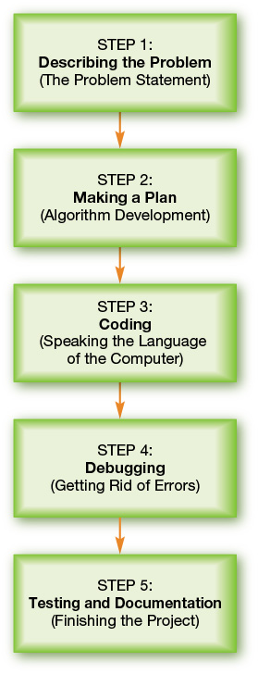
Life Cycle of a Program The Program Development Life Cycle (Objective 10.3)
Programming - translating a task into commands that a computer uses to perform the task
Program development life cycle (PDLC)
Stages a project goes through from development to deployment
Notes:
Programming is the process of translating a task into commands that a computer uses to perform the task.
Program development life cycle (PDLC) is the process of moving through the stages a project goes through from development to deployment.

Slide 11
Life Cycle of a Program The Problem Statement (1 of 2) (Objective 10.3)
Starting point of programming
Clear description of tasks to be performed
Understand goals of programming
Interact with users
Data is raw input
Information is the result
Method is the process of converting inputs into proper outputs
Notes:
The problem statement is the starting point of programming.
It provides a clear description of tasks to be performed.
It helps the programmer understand goals of programming.
The goal of a good problem statement is to have programmers interact with users in these three areas:
Data is raw input.
Information is the result.
Method is the process of converting inputs into proper outputs.

Slide 12
Life Cycle of a Program The Problem Statement (2 of 2) (Objective 10.3)
Error handling
What program should do when errors happen
Includes a testing plan
Addresses probable errors
Notes:
Programmers must describe what the program should do if the input is invalid. This is referred to as error handling.
The testing plan can’t list every input. Instead, programmers identify categories of inputs, find an example, and specify what output must be generated.

Slide 13
Life Cycle of a Program Algorithm Development (1 of 5) (Objective 10.5)
Set of steps that describe what the program must do to complete its task
Algorithms are limited
Algorithms represented through flowcharts
Provides visual representations of patterns
Pseudocode is a text-based approach to documenting an algorithm
Notes:
An algorithm is a set of steps that describe what the program must do to complete its task.
Algorithms are limited.
Algorithms are represented through flowcharts.
It provides visual representations of patterns.
Pseudocode is a text-based approach to documenting an algorithm.

Slide 14
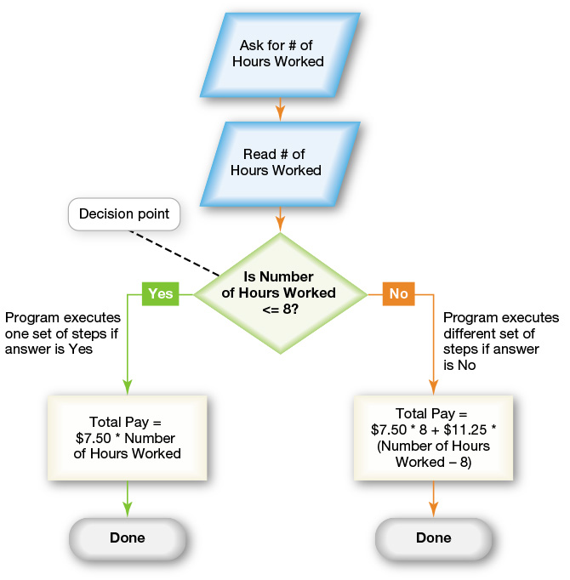
Life Cycle of a Program Algorithm Development (2 of 5) (Objective 10.5)
Flow Control
Programmers handle complex algorithms
List of choices
Decision points
Binary decisions
Loops
Initial value
Test condition
Control structures
Notes:
Complex problems involve choices. Algorithms include decision points.
Binary decisions are questions that can be answered in either yes (true) or no (false).
Loops are when a question is asked. If the answer is yes, actions are performed. Once the actions have finished, the question is asked again, creating a loop. When the answer is no, the algorithm moves to the first step that follows the loop.
The initial value is the beginning point.
A test condition checks to see if the loop is completed.
Control structures are keywords in a programming language that allow the programmer to direct the flow of the program based on a decision.

Slide 15
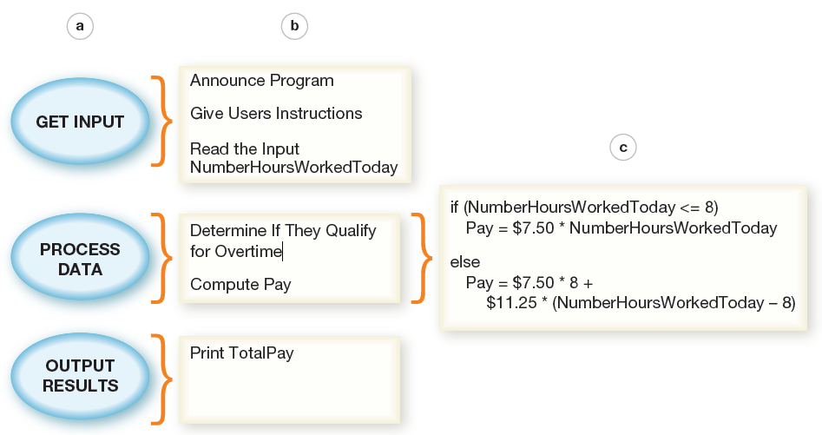
Life Cycle of a Program Algorithm Development (3 of 5) (Objective 10.5)
Design Methodology: Top-Down Design
Problem is broken into series of high-level tasks
Detailed subtasks created from high-level tasks
Continue until steps are close to programming language commands
Notes:
Top-down design is a systematic approach in which a problem is broken into a series of high-level tasks. In top-down design, programmers apply the same strategy repeatedly, breaking each task into successively more detailed subtasks.
They continue until they have a sequence of steps that are close to the types of commands allowed by the programming language they’ll use for coding.

Slide 16
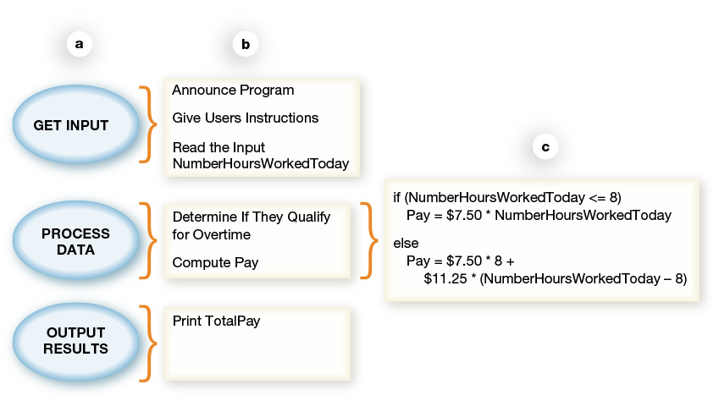
Life Cycle of a Program Algorithm Development (4 of 5) (Objective 10.5)
Top-down design is an approach in which a problem is broken into a series of high-level tasks
Notes:
Top-down design is an approach in which a problem is broken into a series of high-level tasks.
In this figure:
(a) A top-down design is applied to the highest level of tasks in our parking garage example,
(b) The tasks are further refined into subtasks, and
(c) Subtasks are refined into a sequence of instructions—an algorithm.

Slide 17
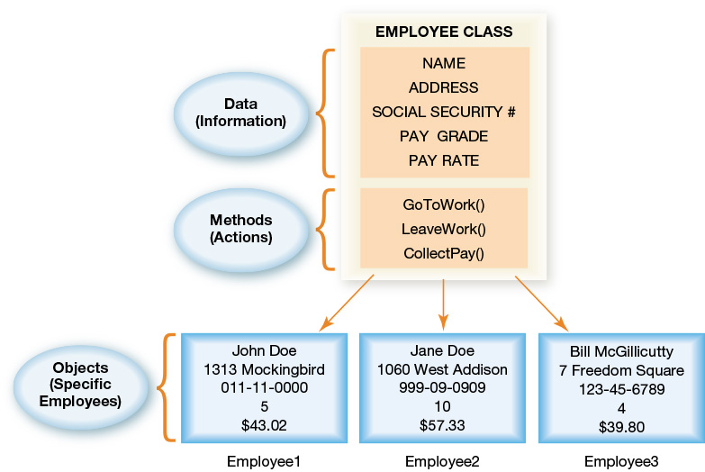
Life Cycle of a Program Algorithm Development (5 of 5) (Objective 10.5)
In Object Oriented Analysis, programmers identify model classes to solve a problem
Notes:
In object-oriented analysis, programmers first identify all the categories of inputs the program is meant to solve. These categories are called classes.
Programmers may need to create several different examples of a class. Each of these examples is an object. In Figure 10.11, John Doe, Jane Doe, and Bill McGillicutty are each Employee objects (specific examples of the Employee class).

Slide 18
Life Cycle of a Program Coding (1 of 5) (Objective 10.6)
Coding: translating an algorithm into CPU instructions
Programmers move from algorithm to code by:
Identifying key pieces of information
Identifying the flow of each step
Converting the algorithm into specific programming language
Notes:
Once programmers create an algorithm, they select the best programming language for the problem and then translate the algorithm into that language. Translating an algorithm into a programming language is the act of coding.
Once programmers have an algorithm, they identify the key pieces of information the algorithm uses to make decisions.
Then they can begin converting the algorithm into computer code in a specific programming language.

Slide 19
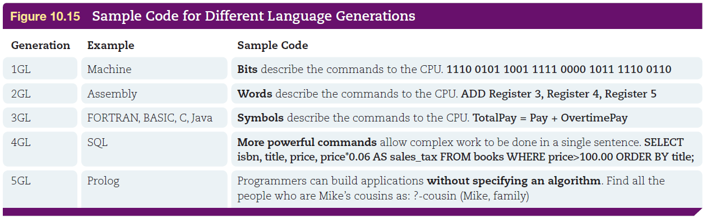
Life Cycle of a Program Coding (2 of 5) (Objective 10.6)
Programming language
A “code” for instructions CPU can perform
Languages use special words and strict rules
Allows control of CPU without knowing hardware details
Five generations of languages
Notes:
A programming language is a kind of “code” for the set of instructions the CPU knows how to perform. Computer programming languages use special words and strict rules so that programmers can control the CPU without having to know all of its hardware details.
Figure 10.15 shows small code samples of examples of each generation of language.

Slide 20
Life Cycle of a Program Coding (3 of 5) (Objective 10.6)
Portability is the capability to move a solution from one type of computer to another
Variables are each input and output a program manipulates
Declarations tell the system to allocate space in RAM
Comments are added to explain the purpose of a section of code
Notes:
Portability is the capability to move a solution from one type of computer to another.
Variables are each input and output a program manipulates.
Declarations tell the system to allocate space in RAM.
Comments are added to explain the purpose of a section of code.

Slide 21
Life Cycle of a Program Coding (4 of 5) (Objective 10.6)
Compilation is the process converting code into machine language (1s and 0s)
Compiler understands syntax of programming language and structure of CPU
Reads source code
Creates an executable program
Some languages use an interpreter
Translates into an intermediate form
Notes:
Compilation is the process by which code is converted into machine language—the language the CPU can understand (1s and 0s).
A compiler is a program that understands bot syntax and programming language and the exact structure of the CPU.
An interpreter translates the source code into an intermediate form, line by line. Each line is executed as it’s translated. The finished program runs faster than an interpreter.

Slide 22
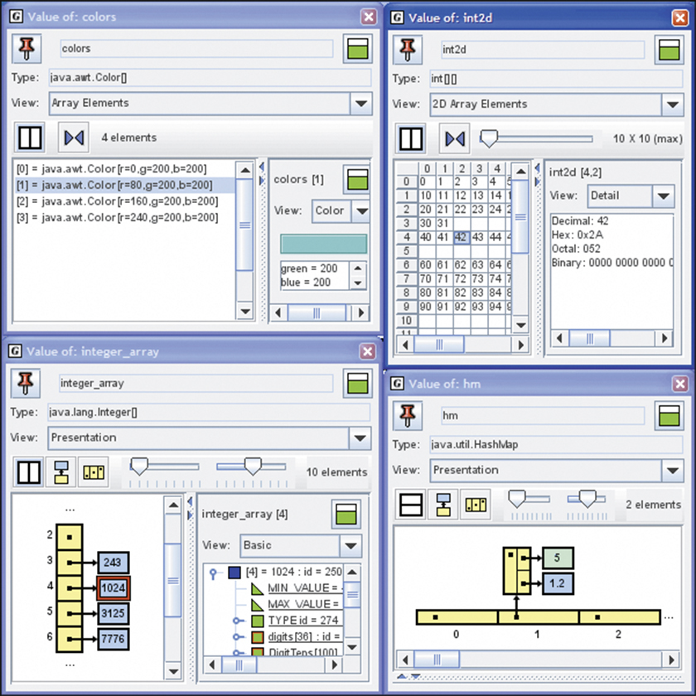
Life Cycle of a Program Coding (5 of 5) (Objective 10.6)
Integrated development environment (IDE) helps programmers write and test their programs
Notes:
An integrated development environment (IDE) is a developmental tool that helps programmers write and test their programs.

Slide 23
Life Cycle of a Program Debugging (Objective 10.7)
Debugging involves finding and correcting errors
Testing plan helps programmers know program has solved the problem
Logical errors
Program runs but executes incorrectly
Runtime errors
For example: dividing by zero
Notes:
The process of running the program over and over to find and repair errors and to make sure the program behaves in the way it should is termed debugging.
A complete testing plan includes sample inputs that exercise all the error handling required as well as all the processing paths.
Logical errors in the problem are caught when the program executes.
Runtime errors include issues like dividing by zero.

Slide 24
Life Cycle of a Program Testing and Documentation (Objective 10.8)
Internal testing
External testing
Solving problems after beta testing
Finishing the project
Release to manufacturers (RTM)
Documentation
General availability (GA)
Notes:
In internal testing, a group uses the program in every possible way.
In external testing, people like those who will use the software work with it.
Before commercial release, software is often provided in a beta version to test sites or to interested users.
Releasing to other manufacturers is called release to manufacturers (or RTM).
Documentation is created.
Finally, the product is in general availability (or GA) and can be purchased by the public.

Slide 25
Programming Languages
Many Programming Languages
Exploring Programming Languages
Notes:
In this section we explore: Many Programming Languages and Exploring Programming Languages.

Slide 26
Many Programming Languages
Objectives
10.9 Discuss the driving factors behind the popularity of various programming languages.
10.10 Summarize the considerations in identifying an appropriate programming language for a specific setting.
Notes:
The two objectives involved in understanding the various programming languages are:
10.9 Discuss the driving factors behind the popularity of various programming languages.
10.10 Summarize the considerations in identifying an appropriate programming language for a specific setting.

Slide 27
Exploring Programming Languages
Objectives
10.11 Compare and contrast modern programming languages.
10.12 State key principles in the development of future programming languages.
Notes:
The two objectives involved in exploring programming languages are:
10.11 Compare and contrast modern programming languages.
10.12 State key principles in the development of future programming languages.

Slide 28
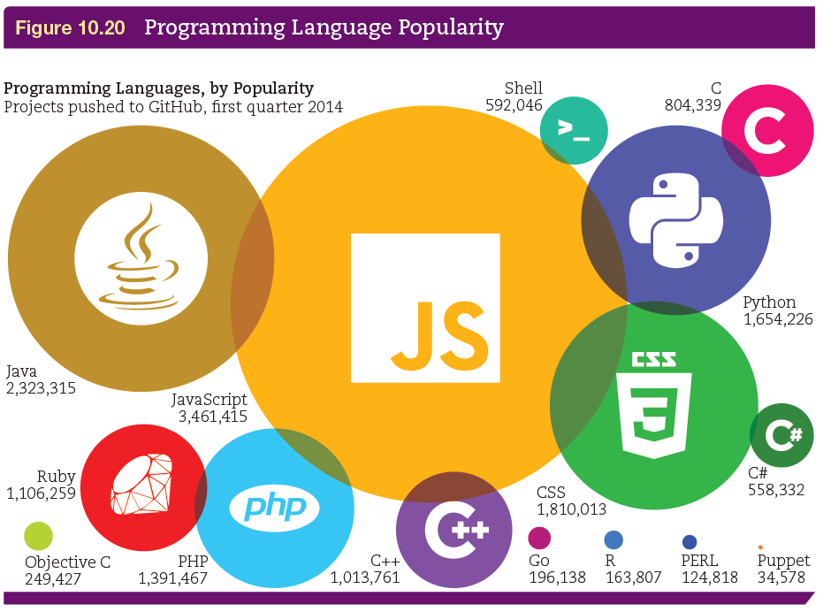
Many Programming Languages Need for Diverse Languages (Objective 10.9)
Examine job postings for programmers
Certain languages dominate in specific industries
Introductory programming course includes:
Design
Algorithm development
Debugging techniques
Project management
Notes:
One quick way to determine which languages are popular is to examine job postings for programmers. As of this presentation, the languages most in demand include C/C++ and Java.
In specific industries, certain languages tend to dominate the work.
A good introductory programming course will emphasize many skills and techniques. You should find a course that emphasizes design, algorithm development, debugging techniques, and project management.

Slide 29

Many Programming Languages Selecting the Right Language (Objective 10.10)
Need to consider:
Space available
Speed required
Organizational resources available
Type of target application
Visual programming language
Scratch
App Inventor
Notes:
A programming team considers several factors before selecting the language it will use for a specific project:
Space available
Speed required
Organizational resources available
Type of target application
Visual programming languages, like Scratch and App Inventor, go even further. They use graphical blocks to represent control elements and variables.

Slide 30
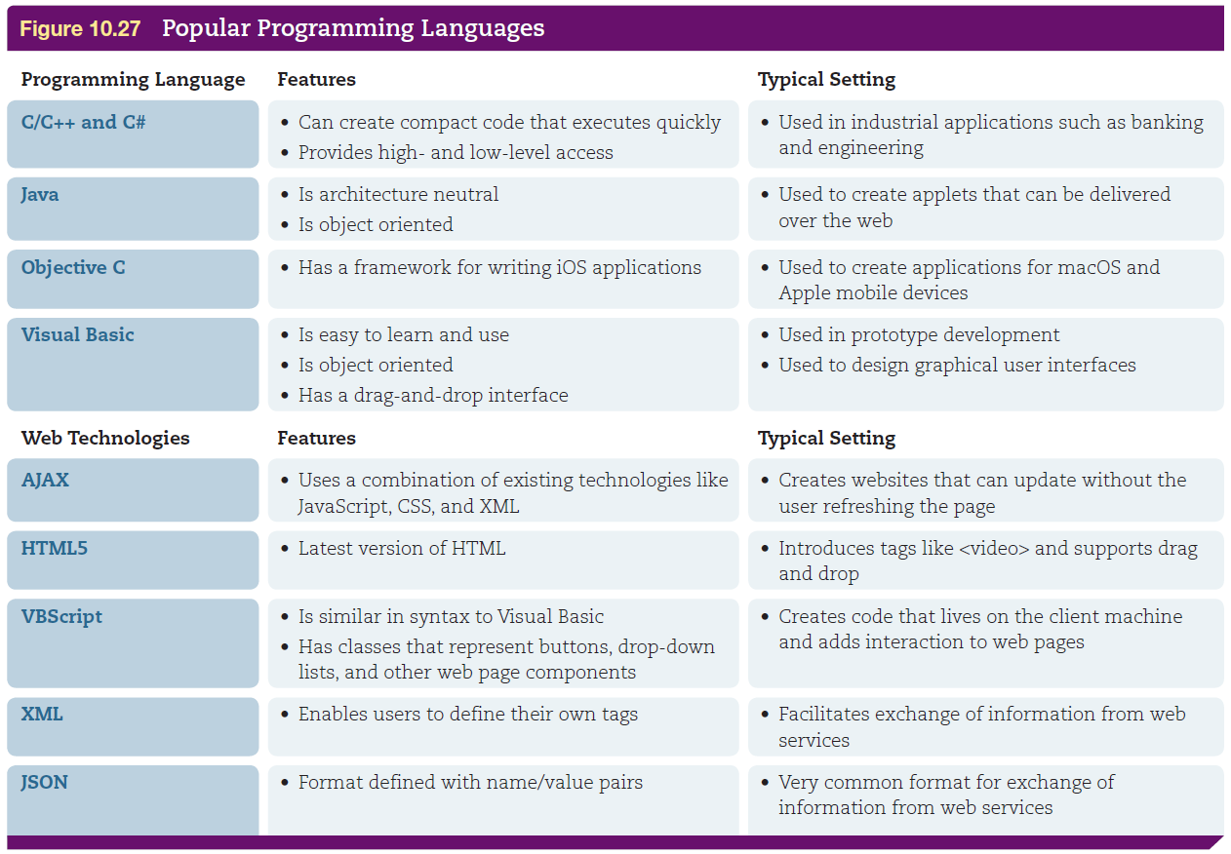
Exploring Programming Languages Tour of Modern Languages (Objective 10.11)
Notes:
Figure 10.27 gives a list of popular programming languages with their features and the typical settings in which they’re used.

Slide 31
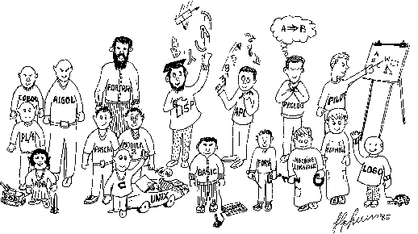
Exploring Programming Languages Future of Programming Languages (Objective 10.12)
Not easy to predict
Visual programming languages
Will always need a variety
Notes:
It is never easy to predict which language will become the next “great” language.
The future may bring a push for the elegance of visual programming. VPLs use visual modeling, creating the code using images to represent each statement, which helps programmers understand complex designs.
There will always be a variety of languages, each with its own personality.

Slide 32
Questions
?

Slide 33
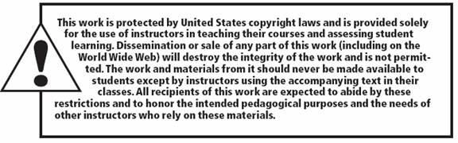
Copyright
All rights reserved. No part of this publication may be reproduced, stored in a retrieval system, or transmitted, in any form or by any means, electronic, mechanical, photocopying, recording, or otherwise, without the prior written permission of the publisher. Printed in the United States of America.

